Slide 1

MULTI AGENT ORCHESTRATION
Automating workflows across Teams & Services
Using LangGraph
and MCP Server

Slide 2

Scenario
A college system has multiple departments:
Exam Cell, Placement Cell, Transport Office, etc.
Each department works independently
exposes its own API services:
Exam Cell → /rescheduleExam
Placement Cell → /checkPlacementClash
Transport → /updateTransport
Placement
Exam Cell
Transport
Orchestrator
Expose API’s as Services
Case: Exam Cell wants to reschedule an exam.
To do this:
Must check with Placement Cell for clashes
If clear → update exam timetable.
Then → notify Transport for schedule adjustment
Task
Orchestrator
Identifies Workflows
The Problem
As more departments & services are added:
Workflows get complex.
The middle person becomes a bottleneck.
System fails to scale → delays, errors, inefficiency.
Invokes API calls
FAIL CASES →
New Workflows
Updates in API’s
Completes Task

Slide 3
AI as a Solution
AI can step in as an intelligent orchestrator :
Understands available services (APIs).
Dynamically generates workflows.
Automates service integration & execution.
Provides reasoning and validation.
This approach is known as Multi-Agent Orchestration.
To understand how AI can act as an orchestrator, we need to understand :
Large Language Models (LLMs): the foundation of reasoning and language understanding.
AI Agents: autonomous entities that use LLMs and tools to perform tasks.
Multi-Agent Collaboration: how multiple agents coordinate to solve complex workflows.
WHO IS AN ORCHESTARTOR ???
An orchestrator is someone (or a system) that connects different services together and makes sure tasks are done in the correct order.

Slide 4
What is an LLM !
LLM (Large Language Model)
An AI model trained on massive text to understand, compare vectors, and generate human-like responses.
How it works:
Text → Tokenization.
Tokens → Converted into vectors in high-dimensional space.
Vectors are compared to predict the next token.
Prediction → Generation of meaningful text.
Types of LLM
GPT - Generative Pretrained Transformer
MoE - Mixture of Experts
VLM - Vision-Language Model
SLM - Small Language Model
LCM - Low-Complexity Model
LRM - Large Reasoning Model
LAM - Large Action Model
HRM - Human Reasoning Model
LLMs we use
LRM (Large Reasoning Model):
Focused on complex reasoning and problem-solving, beyond simple text prediction.
LAM (Large Action Model):
Designed to take actions by invoking external tools, APIs, or services.
HRM (Human Reasoning Model):
Works as a support layer for real-time suggestions and context-aware decisions, often involving human feedback.

Slide 5
What is an Agent !
What is an Agent?
Agent = An autonomous system that perceives its environment, reasons, and acts to achieve goals.
Agents follow the PEAS model: Performance measure, Environment, Actuators, Sensors.
What is a State?
State = A snapshot of the environment at a given moment (what the agent "knows" right now).
Example: In a chess game, the state = current board configuration.
Example: For a chatbot, the state = current conversation history + user input.
Types of Agents:
Simple Agent –
Acts only on the current state; no memory of the past.
Example: A light sensor that switches on/off based only on brightness.
Goal-Based Agent –
Chooses actions that lead to a specific desired state (goal).
Example: A navigation app finding a route to your destination.
Utility-Based Agent –
Considers multiple possible goals and trade-offs, picking the action with the highest utility (usefulness/benefit).
Example: A self-driving car deciding between fastest vs. safest route.
Utility-Based Agent in AI/LLMs
Focuses on achieving the goal, but also evaluates utility parameters like efficiency, accuracy, cost, or time.
Selects the action that not only reaches the goal but also maximizes overall benefit.
In LLM systems, this allows agents to reason, call tools, and optimize outcomes, rather than just generate text.

Slide 6
Multi Agent Orchestration
Definition:
Multi-Agent Orchestration is the coordination of multiple autonomous agents, each with specialized roles, to collaboratively achieve a complex goal.
Role of HITL:
Mandatory for critical decisions, ambiguous situations, and error handling.
Ensures trust, safety, and regulatory compliance in industrial applications.
Need for a multi agent system and implementation :
A single agent working on a complex task can face overhead, bottlenecks, or incomplete reasoning.
In a multi-agent system:
Reasoning Agent (LRM): Plans the workflow and handles logical decision-making.
Invoke Agent (LAM): Executes actions, calls APIs, and interacts with services.
Human-in-the-Loop (HITL): Provides validation, resolves ambiguities, and ensures safety.
Agents communicate and share state to complete the workflow efficiently.
Why this is a better industrial approach:
Parallelization: Multiple agents handle different parts of the workflow simultaneously.
Scalability: Adding new services or teams doesn’t overload a single agent.
Accuracy: Each agent specializes in a task; errors are reduced.
Human oversight: Ensures high reliability and safety in production environments.

Slide 7
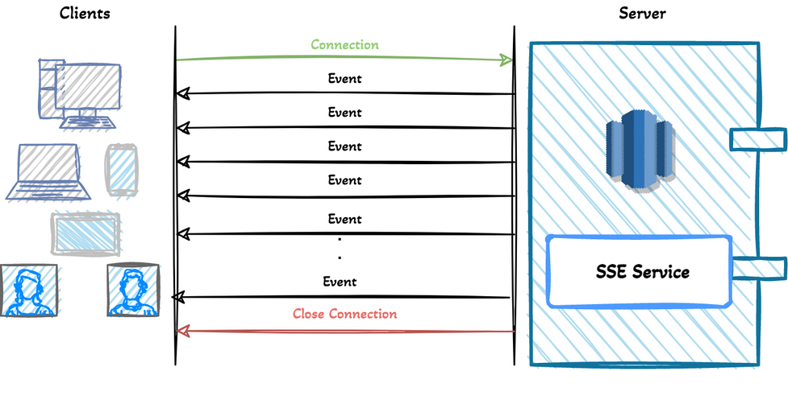
Requirements for Agents !
Transport Protocols
HTTP (Normal): Request → Response. One-time, stateless communication.
WebSockets: Full-duplex connection, allows real-time bidirectional communication.
SSE (Server-Sent Events): Server can push updates to client; client cannot push back on same connection.
Streamable HTTP: Hybrid approach; streams data over HTTP without opening a persistent socket.
Memory & Context
Context → Knowledge required by the agent for reasoning
Memory: Stores past interactions, states, or outputs to make future decisions consistent.
Additional Knowledge: Workflows generated for other relevant prompts from other users.
Together, memory + additional knowledge = the agent’s context for accurate reasoning.
Memory = full history (like your brain’s storage).
Context = what the agent is currently paying attention to.
Prompt
A prompt is the input given to an agent or LLM to guide its reasoning and actions.
Role in Agents:
Defines the role of the agent (e.g., reasoning, tool-invoking).
Specifies the goal of the agent (what it needs to achieve).
Types of Prompts:
Developer Prompt
User Prompt

Slide 8
Tools for Multi Agent Orchestration
There are several frameworks available in the market to orchestrate LLM agents:
LangChain
Designed to chain LLM calls with tools in a sequential manner.
Suitable for simple linear workflows.
Limitation: Cannot handle dynamic runtime decisions, conditional branching, or complex multi-agent coordination.
LlamaIndex
Primarily used for Retrieval-Augmented Generation (RAG).
Helps LLMs access external knowledge bases efficiently.
Limitation: Focused on retrieval; not meant for full orchestration of multiple agents or workflows.
CrewAI
Open-source framework for multi-agent setups.
Allows agents to communicate and coordinate.
Limitation: Lacks predefined workflows, no production-ready support, and requires heavy manual setup for industrial use.
LangGraph
Graph-based orchestration: Workflows are represented as nodes (agents, tasks) and edges (conditional or sequential transitions).
Supports dynamic decision-making at runtime, interrupts, and state management.
Enables Human-in-the-Loop (HITL) integration for critical validation.
Allows snapshotting, logging, and rollback, making it production-ready.
Scalable for multiple agents, teams, and services while maintaining context and memory.
Simplifies connecting existing APIs and workflows via standard interfaces (MCP servers).

Slide 9
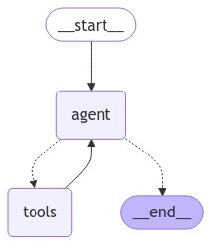
LANGGRAPH !
LangGraph as a Wrapper:
LangGraph builds on top of LangChain, adding graph-based orchestration, runtime decision-making, conditional logic, and state management.
Essentially, it enhances LangChain’s capabilities for complex multi-agent workflows.
LangChain Community:
Large, active community with plugins, integrations, and examples.
Provides the base for agents, tools, chains, and some memory support.
KEY COMPONENTS IN LANGGRAPH
Nodes → Represent agents, tools, or tasks in the workflow.
Edges → Define communication and execution paths between nodes.
Conditional Edges → Enable branching logic.
State in LangGraph → Centralized memory & context storage:
Tracks conversation history, workflow progress, and relevant context.
Stores snapshots at each step for rollback or re-invocation.
Enables resumable workflows, error recovery, and HITL integration.
Other Important Terminologies / Takeaways:
Interrupts
Checkpointers
MCP Adapters

Slide 10
AGENTIC MEMORY
Definition:
Enables agents to store past interactions, context, and workflow state for accurate reasoning.
Essential for multi-step decision-making and maintaining conversation continuity.
Redis-Based Solution
LangChain community provides synchronous Redis connection.
RedisChatMessageHistory → memory class from lang chain community
Custom memory classes can wrap it to provide async support.
Benefits:
Persistent, scalable, and accessible across multiple users.
Stores memory in Redis DB instead of volatile server RAM.
Can integrate conversation history, workflow state, and summaries efficiently.
Custom Async Redis MMY:
Developers can override read/write methods.
Implements multi-user support and resilient memory even on server restart.
DEFAULT MEMORY OPTIONS IN LANGGRAPH →
Conversation Buffer → Stores all messages sequentially.
Window Memory → Keeps only the last N messages (sliding window).
Knowledge Graph → Represents relationships between entities.
Summary Memory → Stores condensed summaries of past interactions.
Runnable with Message History:
Lets developers define custom memory classes (MMY) using prior messages.
Helps simulate full memory behavior for testing and workflows.
Limitations
Primarily single-user oriented.
RAM-based MMY storage:
Multiple MMY objects for multiple users are stored in a Python dictionary
Fails under horizontal scaling (multiple servers).
Memory lost on server restart → not reliable for production.

Slide 11
VECTOR DATABASE !
Need for Vector DB:
For a current prompt, an agent works better if it retrieves:
Other relevant prompts.
Outputs generated by the agent for those prompts.
Whether these outputs were admin-approved.
Helps the agent provide more accurate, relevant, and validated solutions.
Indexing Methods
HNSW (Hierarchical Navigable Small World)
Excellent for fast nearest-neighbor search.
Cons: Costly for updates & deletes, but inserts are fast.
Proprietary Graph Algorithm → Microsoft Fresh Disk ANN
Balanced performance for insert, delete, and update, but mediocre overall.
Vector Database
Purpose: Stores embeddings for semantic search to retrieve relevant context efficiently.
How it works:
Convert text (prompts, outputs) into vectors (embeddings) that capture semantic meaning.
Store these vectors in a vector DB.
Query the DB using a new prompt vector to find semantically similar past prompts/outputs.
Vectors & Embeddings:
Vector: A numerical representation of text in multi-dimensional space.
Embedding: The mapping of text → vector such that semantically similar texts are close in vector space.
Why Qdrant with HNSW over Pinecone
Mostly insert-only workloads, so HNSW’s costly updates/deletes are not an issue.
Open-source & production-ready, fully customizable for our multi-agent setup.
Full control over embedding storage, retrieval, and context management.
Can be self-hosted or integrated easily with LangGraph agents.

Slide 12
MCP SERVERS
Recall Slide 2 Scenario:
College with multiple departments: Exam Cell, Placement, Transport.
Departments expose services as APIs.
A task like rescheduling an exam requires cross-department coordination.
Problem for LLM Agents:
How does an agent call these APIs safely and reliably?
Without a standard:
Agents may misuse services.
Workflows can fail.
Security and consistency issues arise.
MCP Server as the Solution
Model Context Protocol (MCP) Server:
A standardized interface that wraps APIs and tools for AI agents.
Ensures secure, reliable, and auditable access to external services.
Helps agents trigger department APIs to complete workflows without worrying about implementation details.
Benefits:
Smooth workflow execution by LLM agents.
Centralized authentication and session management.
Logs all requests for monitoring and verification.
Supported Platforms:
TypeScript & Python implementations available.
Go development is ongoing for broader adoption.
Global Standard:
MCP or similar protocol wrappers are widely used worldwide to safely connect AI agents to external tools and services.

Slide 13
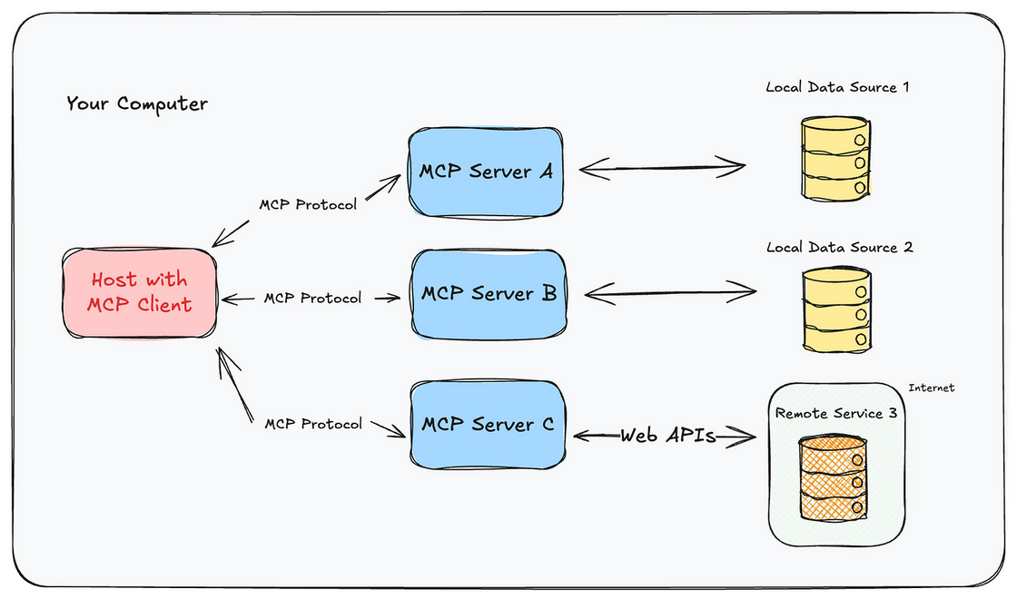
AUTH IN MCP SERVER
How We Resolve This:
Multi-layer Authentication & Authorization
Verify user/session identity at multiple levels.
User session is always passed as a parameter.
Confidence Scores
Only allow agent actions above a certain confidence threshold.
MCP as a Wrapper
All requests routed to DB server for verification and logging.
Ensures integration with existing systems is seamless.
Tool Access Restrictions
Agents can only access tools they are authorized for.
Performance Management
Centralized request handling prevents overload.
Potential Vulnerabilities in MCP:
Confused Deputy Problem: Agent unintentionally uses higher privileges than intended.
LLM Misuse: May call APIs in unsafe or unexpected ways.
Performance Degradation: Unregulated or excessive requests overwhelm the system.
Outcome:
Prevents unauthorized access.
Reduces misuse of APIs.
Maintains workflow continuity and production reliability.
Enables secure multi-agent orchestration with accountability.

Slide 14
HUMAN IN THE LOOP - HITL
Importance of HITL
Ensures critical decisions are validated by humans.
Balances automation with oversight.
Prevents errors from LLM reasoning or workflow execution.
Roles of Agents & Humans
Reasoning Agent (LRM)
Generates workflows for tasks.
Primary goal: reuse existing, admin-approved workflows.
Workflow validation:
If using admin-approved workflow → confirm with user before execution.
If a new workflow → verify with admin before proceeding.
Invoke Agent (LAM)
Executes the workflow generated by the reasoning agent.
Calls APIs, triggers tools, and ensures step-by-step execution.
Human in the Loop
User: Requests tasks, approves standard workflows.
Admin: Validates new workflows, overrides decisions, ensures compliance.
Interrupts in LangGraph
How Interrupts Work:
Pauses workflow execution to review, validate, or reroute tasks.
Checkpointers & Snapshots:
Checkpointers take snapshots of agent state at specific points.
Snapshots can be saved in:
Redis → fast recovery, shared across agents.
SQL Database → persistent storage.
Python Server RAM → temporary runtime access.

Slide 15
PRODUCTION READINESS AND ADVANCEMENTS
PRODUCTION READINESS & ROLL BACKS
(HANDLING FAIL OVERS )
Logging:
Record all agent requests, workflow steps, and states for monitoring and debugging.
Rollback Strategies:
LangGraph server fails → restore from snapshots + replay logs of states.
MCP / DB server fails → save current state, notify admin, log all activities.
Unauthorized access detected → flag session, notify admin, take corrective action.
Admin decisions:
Can manually rollback workflows.
Or system can retry workflow execution after a defined interval.
Future Advancements
HRM (Human Resource Module) Wrapper:
Provides real-time context and intelligent suggestions to agents and admins.
Example: Auto-assist admin in approving new workflows or verifying outputs.
Monitoring Agent:
Continuously monitors workflow execution, API calls, and agent behavior.
Detects security issues, anomalies, or unexpected behavior.
Ensures robust validation and additional layer of safety for production systems.

Slide 16

Thank you!

